Slide 1
A Test-Driven Approach to Improving Student Contributions to Open-Source Projects
Zhewei Hu
Yang Song
Edward F. Gehringer
Department of Computer Science
North Carolina State University
{Hu6, ysong8, efg}@ncsu.edu

Slide 2
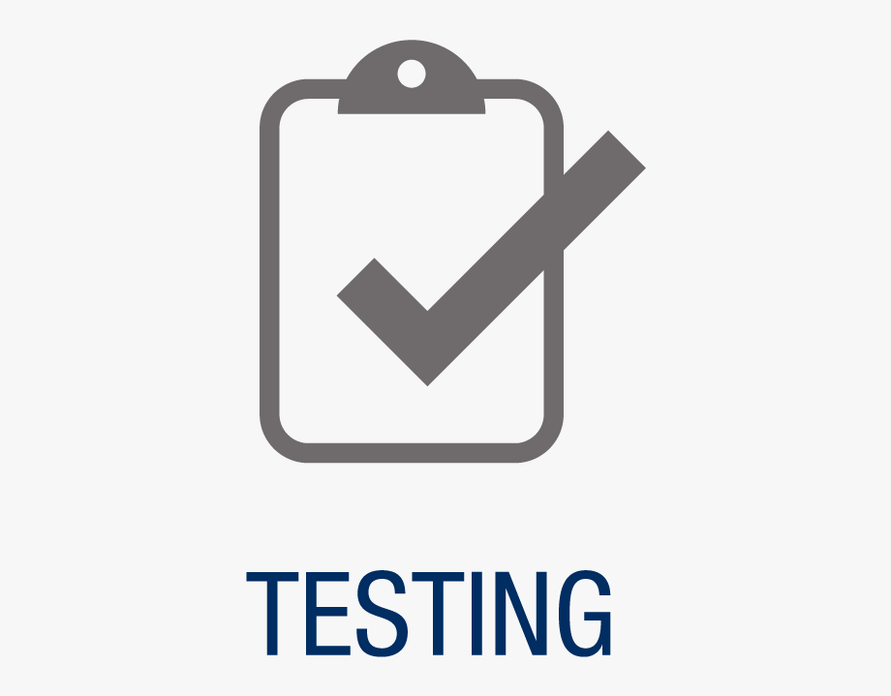
Test-Driven Development
Write tests first, code later
Assures tests get written
But does it improve code quality?
Much research done in classes, but …
… based on throwaway projects
Hu et al., Improving Feedback on GitHub Pull Requests: A Bots Approach
Notes:
George & Williams, 2004: TDD programmers’ code passed 18% more functional tests, but took 16% longer to program
Maria Siniaalto ; Pekka Abrahamsson 2007:
It may not improve quality when done by inexperienced developers, though it does ^ test coverage.

Slide 3

Our course
Masters-level course in Object-Oriented Design and Development
Up to 10% advanced undergraduates
Students work mostly on existing code
Refactoring
Writing tests
Adding features
Hu et al., Improving Feedback on GitHub Pull Requests: A Bots Approach

Slide 4
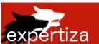
Our experiment
Quasi-experimental
Based on the peer-assessment system
30,000 LoC
Refactoring projects on files with low or no test coverage,
and rated “F” by Code Climate
Students were provided with test skeletons.
TDD group wrote tests before refactoring
Hu et al., Improving Feedback on GitHub Pull Requests: A Bots Approach

Slide 5
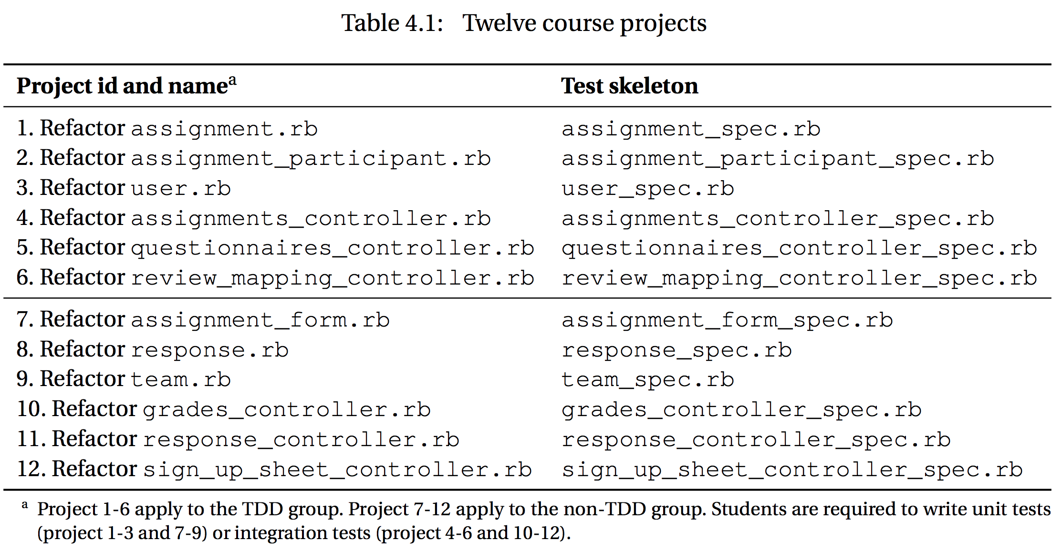
Experiment design
Notes:
- Quasi-experimental controlled study
- They worked on course projects in teams:
- half of which were assigned to the TDD group (using the test-driven approach)
- the rest of which were assigned to the non-TDD group (using the traditional test-last approach).
- Therefore, we consider that students in the TDD group adhered to the test-driven approach pragmatically (20%) during their course projects and those in the non-TDD group did not comply with the test-driven approach.

Slide 6
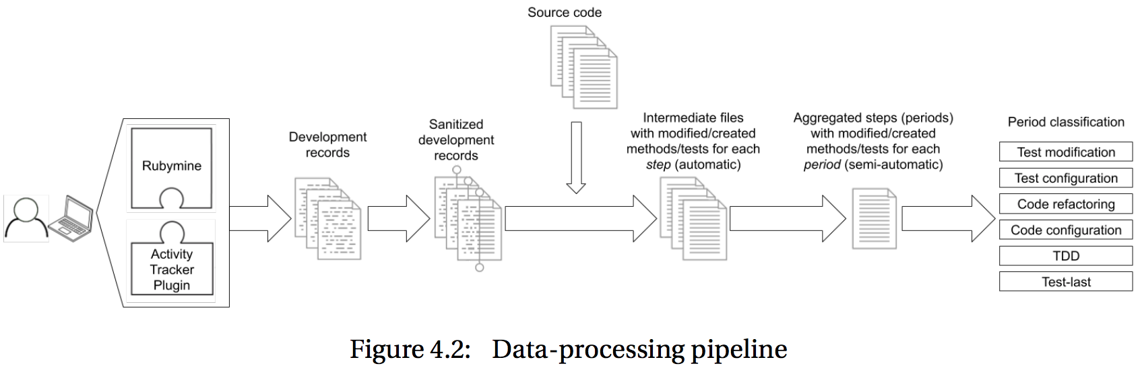
Examination of compliance with the TDD process
2017-10-20T17:13:40.545, KeyEvent, 103:71:0, Editor, /home/expertiza_developer/Desktop/expertiza/spec/models/user_spec.rb, 148, 13
2017-10-20T17:13:40.608, KeyEvent, 101:69:0, Editor, /home/expertiza_developer/Desktop/expertiza/spec/models/user_spec.rb, 148, 14
2017-10-20T17:13:40.849, KeyEvent, 116:84:0, Editor, /home/expertiza_developer/Desktop/expertiza/spec/models/user_spec.rb, 148, 15
Hu et al., Improving Feedback on GitHub Pull Requests: A Bots Approach
Notes:
RubyMine plugin Activity Tracker records timestamp, keyboard events, current location of cursor.
- Explain the record
- http://www.asciitable.com/index/asciifull.gif
- java.awt.event
- 103:71:0 → g
- 101:69:0 → e
- 116:84:0 → t

Slide 7
Examination of compliance with the TDD process
2017-10-20T17:13:40.545, user_spec.rb, describe '#get_instructor' do
2017-10-20T17:13:40.608, user_spec.rb, describe '#get_instructor' do
2017-10-20T17:13:40.849, user_spec.rb, describe '#get_instructor' do
Hu et al., Improving Feedback on GitHub Pull Requests: A Bots Approach
Notes:
- Intermediate files with modified/created methods/tests name
- 3 intermediate files: user_spec.rb with modified tests

Slide 8
Examination of compliance with the TDD process
2017-10-20T17:03:02.145-2017-10-20T17:53:58.324, user_spec.rb, describe '#get_instructor' do
Hu et al., Improving Feedback on GitHub Pull Requests: A Bots Approach
Notes:
- One-hour threshold

Slide 9
Examination of compliance with the TDD process
2017-10-20T17:03:02.145-2017-10-20T17:53:58.324, user_spec.rb, describe '#get_instructor' do, test modification
Hu et al., Improving Feedback on GitHub Pull Requests: A Bots Approach
Notes:
http://www.asciitable.com/index/asciifull.gif
103:71:0 → g
101:69:0 → e
116:84:0 → t

Slide 10
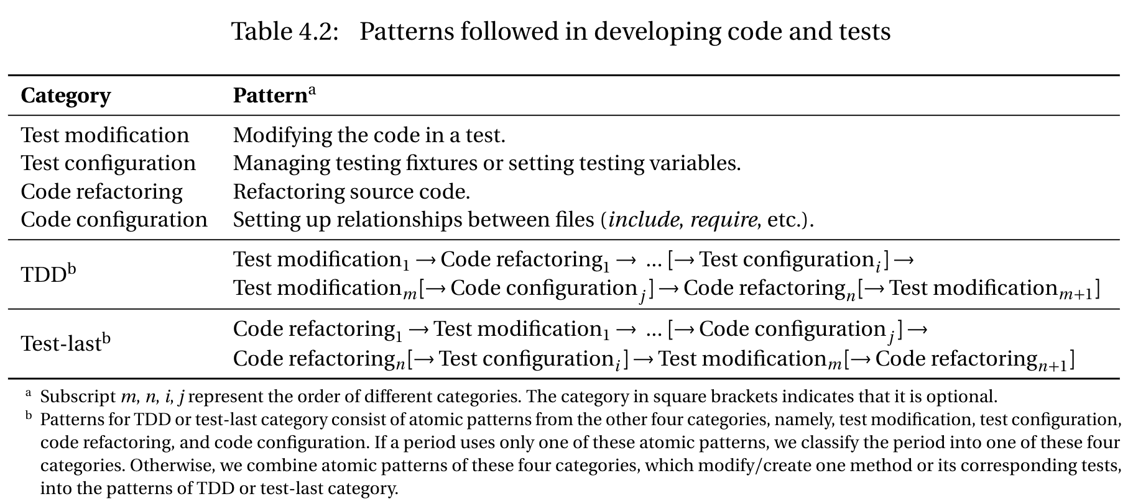
Examination of compliance with the TDD process
Hu et al., Improving Feedback on GitHub Pull Requests: A Bots Approach
Notes:
- First four are atomic patterns.
- TDD and test-last patterns are the combination of four atomic patterns.
- Therefore, we consider that students in the TDD group adhered to the test-driven approach pragmatically (20%) during their course projects and those in the non-TDD group did not comply with the test-driven approach.

Slide 11
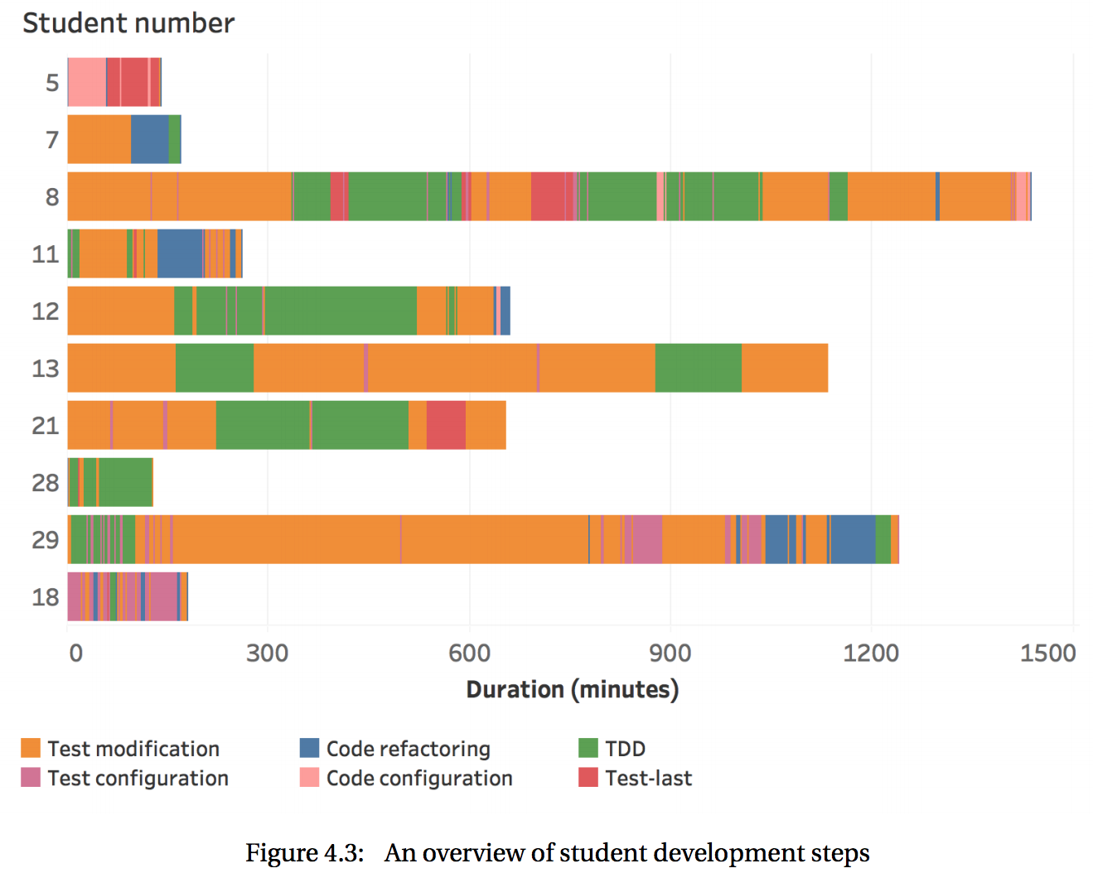
Examination of compliance with the TDD process
Average percentage of time complying with the test-driven approach
TDD group: 31% (median 22%)
Non-TDD group: 6% (median 6%)
Students in the TDD group adhered to the test-driven approach pragmatically (20%) and those in the non-TDD group did not comply with the test-driven approach.
Notes:
- All are from TDD group, except student 18, who is from non-TDD group.
- It is worth noting that one big rectangle can include many periods. I omitted the border of each period to make the graph easy to view.
- Based on the literature review, developers in both industry and academy did not comply with the TDD approach all the time.
- Therefore, we consider that students in the TDD group adhered to the test-driven approach pragmatically (20%) during their course projects and those in the non-TDD group did not comply with the test-driven approach.

Slide 12
Test quality statistical analysis
Analyzed 301 newly added tests
TDD group: 203 tests
Non-TDD group: 98 tests
Metrics
Statement coverage
Mutation Score Indicator (MSI)
Method 1
Test 1
Test 2
60% statement coverage
Hu et al., Improving Feedback on GitHub Pull Requests: A Bots Approach
Notes:
- Reduce the granularity to test-level, instead of project-level
- Data points involved in statistical analysis will smaller than number of tests.
- MSI: a mutated program that produces failed tests is a killed mutant; if the tests pass, then it is an escaped mutant.

Slide 13
Statistical analysis of test quality
 | Average statement coverage per method | Average MSI per method
TDD group | 91% (median 100%) | 74% (median 78%)
Non-TDD group | 79% (median 92%) | 65% (median 68%)
One-sided Wilcoxon rank-sum test
Statement coverage: p = 0.00044 < 0.05
MSI: p = 0.058 > 0.05
Hu et al., Improving Feedback on GitHub Pull Requests: A Bots Approach
Notes:
- Non-parametric tests

Slide 14
Code quality
Merge status | TDD group | Non-TDD group
Merged | 2 | 2
Partially merged | 2 | 3
Rejected | 2 | 1
Common mistakes: things like
bad commenting
bad naming
duplicated code
failing functionality
hardcoding
long methods
 | TDD group | Non-TDD group
Average common mistakes | 1.8 | 1.8
Median common mistakes | 1.5 | 2
Hu et al., Improving Feedback on GitHub Pull Requests: A Bots Approach

Slide 15

Conclusions
TDD group was able to apply test-driven techniques pragmatically.
No major differences in the quality of source code modifications and newly created tests between two groups.
TDD group wrote more tests and achieved significantly higher (12% more) statement coverage.
Hu et al., Improving Feedback on GitHub Pull Requests: A Bots Approach

Slide 16

Thank you!
Any questions?
Hu et al., Improving Feedback on GitHub Pull Requests: A Bots Approach

